Slide 1




FedVision: An Online Visual Object Detection Platform Powered by Federated Learning
Yang Liu, Anbu Huang, Yun Luo, He Huang, Youzhi Liu, Yuanyuan Chen, Lican Feng, Tianjian Chen, Han Yu, Qiang Yang

Slide 2

Two Secrets of AI’s success : Computing Power and Big Data
Computing power Big data
The New Rich
1 ZB= 10²¹Byte
Intel i386
Intel i486
Intel Pentium
Intel Core
Nvidia GPU
Google TPU
9

Slide 3


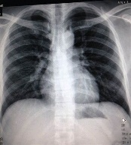

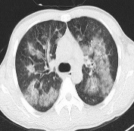
Motivation
Data exists in the form of isolated islands
Company A
Company B
Data integration between different departments of the same company faces heavy resistance
X1
(X2, Y)
Almost impossible to integrate the data scattered around the country and institutions
Due to data privacy and data security, it is unfeasible to share sensitive data.
Medical diagnosis

Slide 4
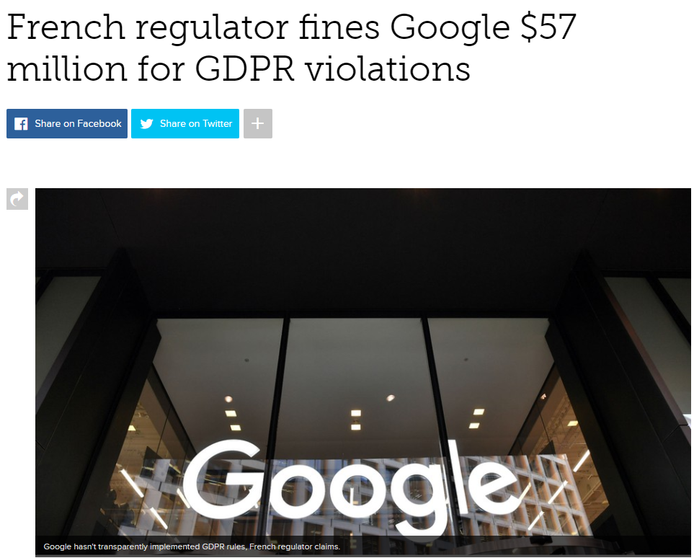
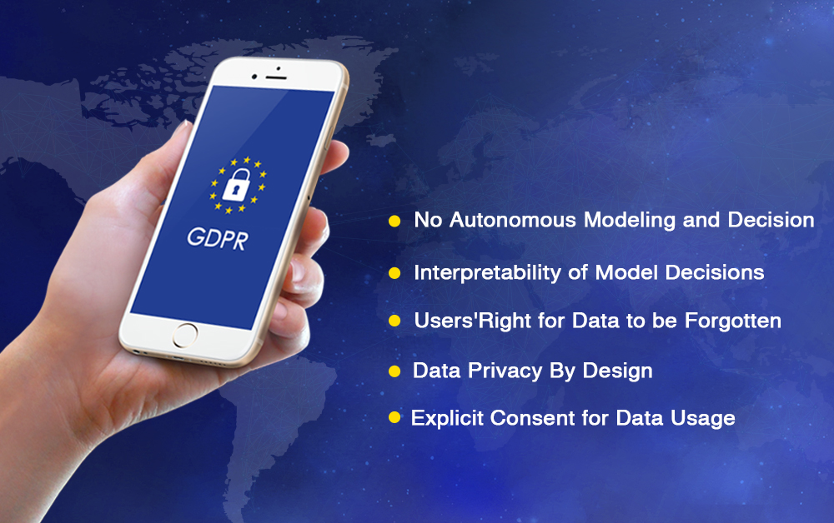
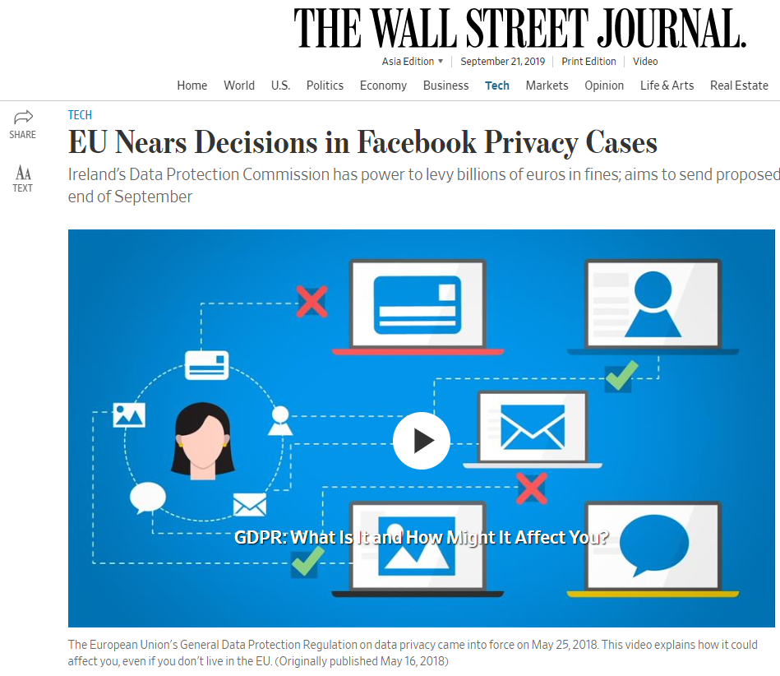
Motivation
Legislation to protection of data security and privacy

Slide 5

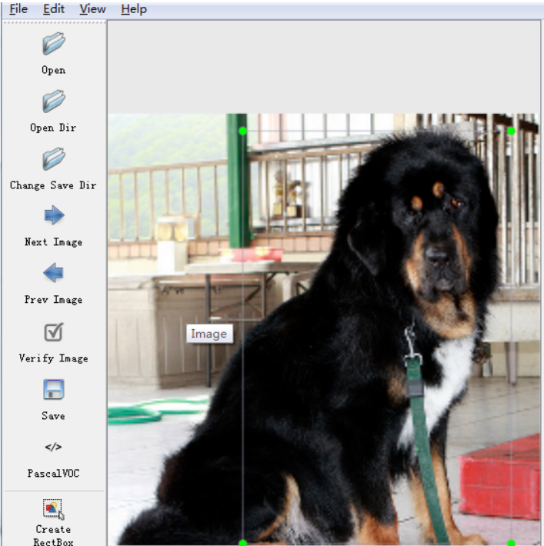
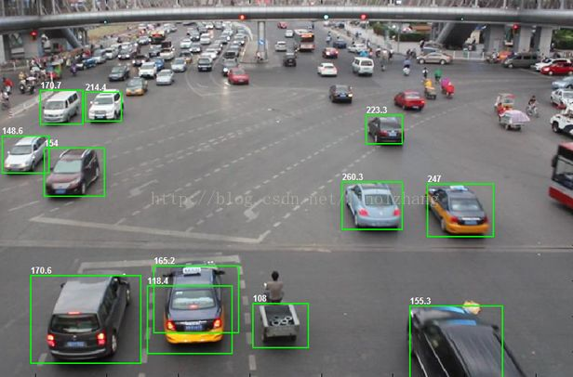
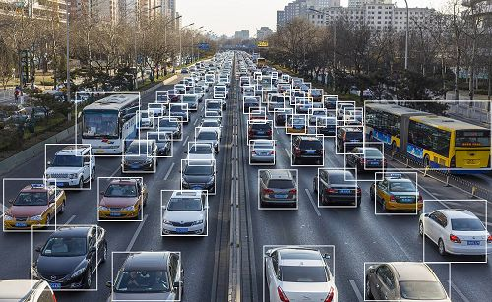

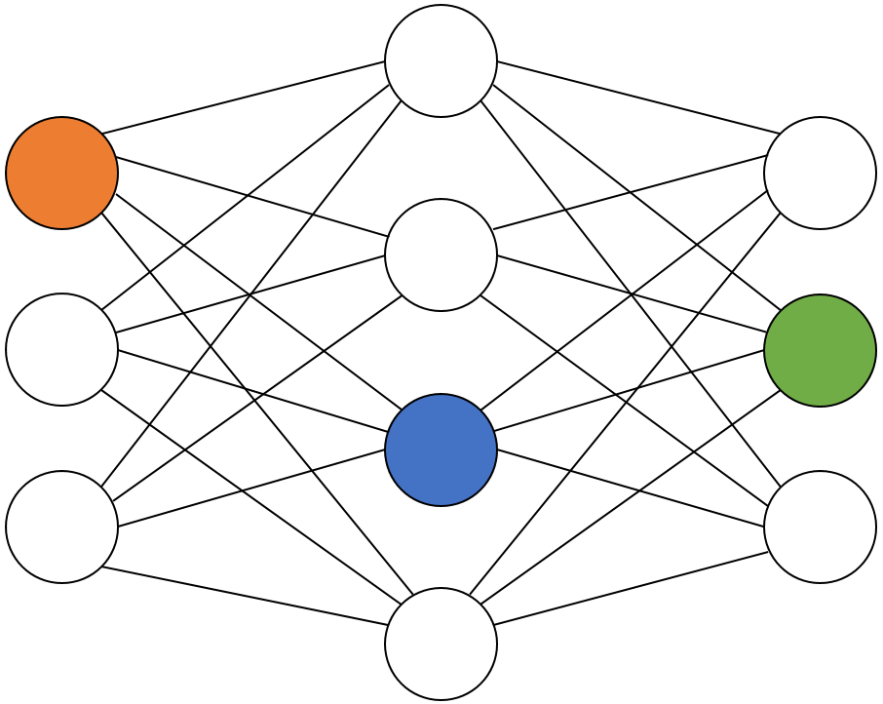
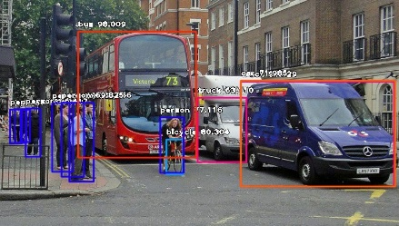
Existing Approaches
user 1
user 2
……
……
user n
Central database
Model training
Online inference
Image Annotation

Slide 6
Fedvision – new machine learning framework
Decouple the need for model training with the need to store the data in the cloud or central database

Slide 7

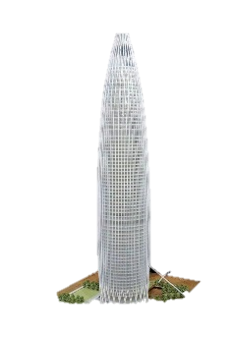
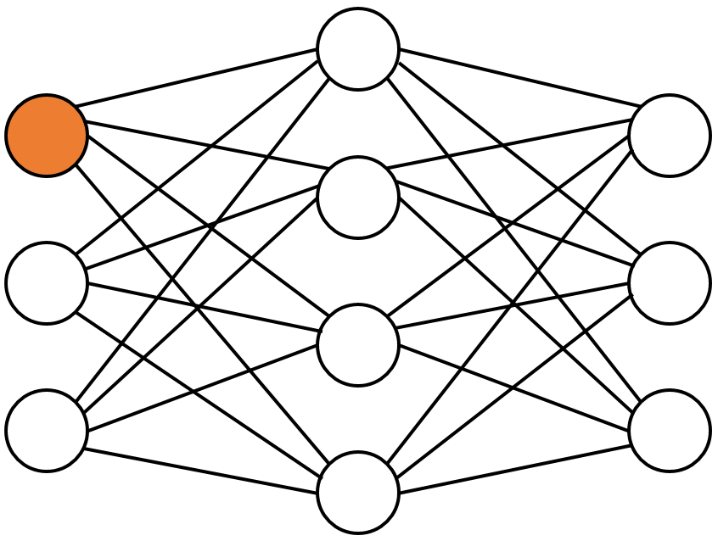
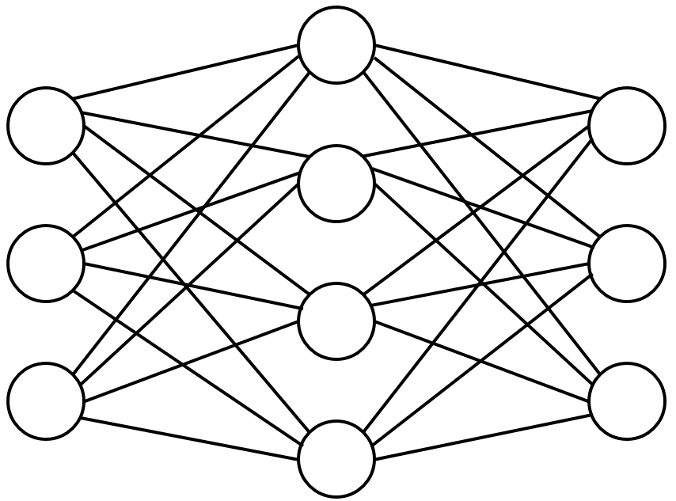
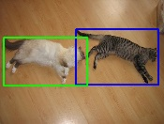

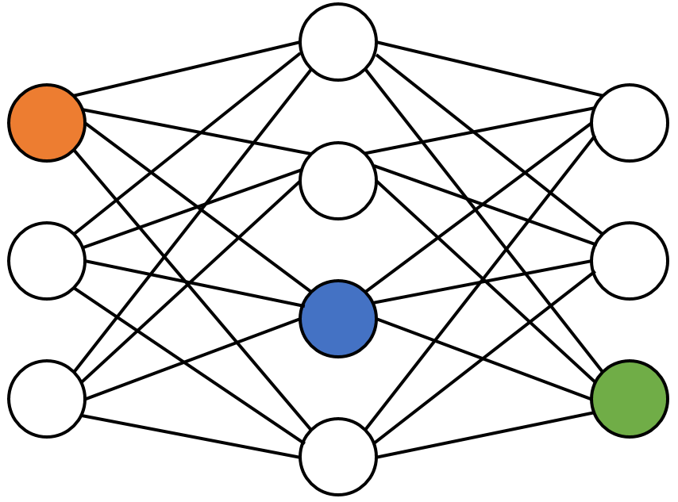
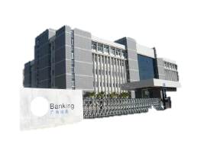
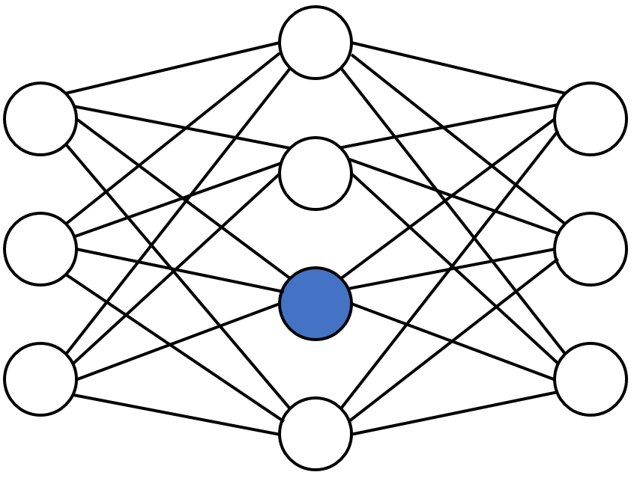
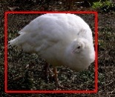
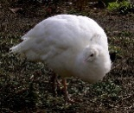

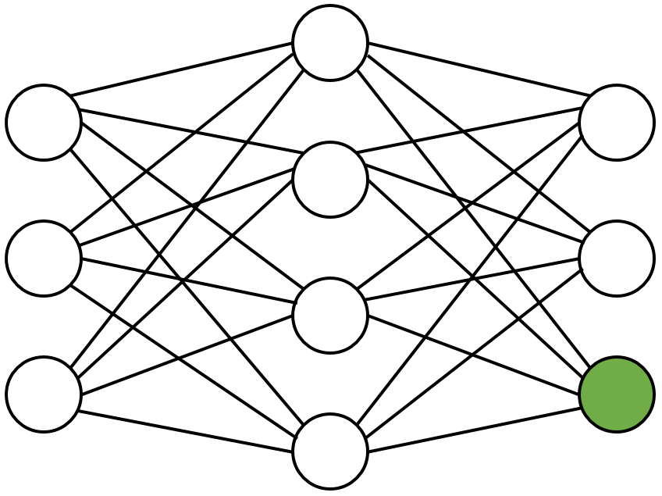
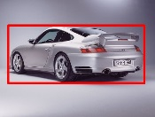


FedVision approach
Local training
Image annotation
CRC
Federated Server
Local training
Image annotation
GRG
Local training
Image annotation
SPIC

Slide 8









System Challenges
Client change dynamically
Resource constraints
Device diversity
Network diversity
1
2
3
4

Slide 9
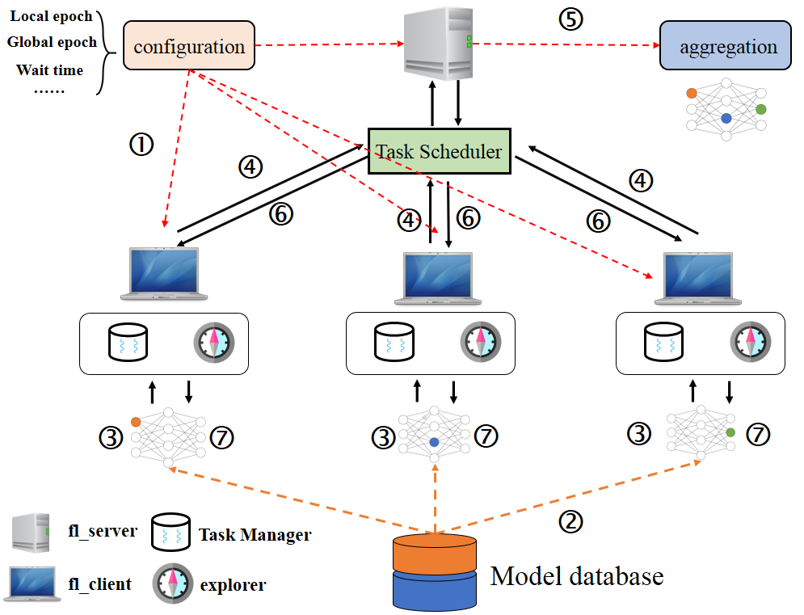
System Architecture

Slide 10
Use of AI Technology
Enables different participants to collaboratively train machine learning model
Data from A
FL distributes the machine learning process over to the edge
user
Data from B
Keep dataset on device locally
feature
Each client has the same input features and model structure
Horizontal federated learning

Slide 11
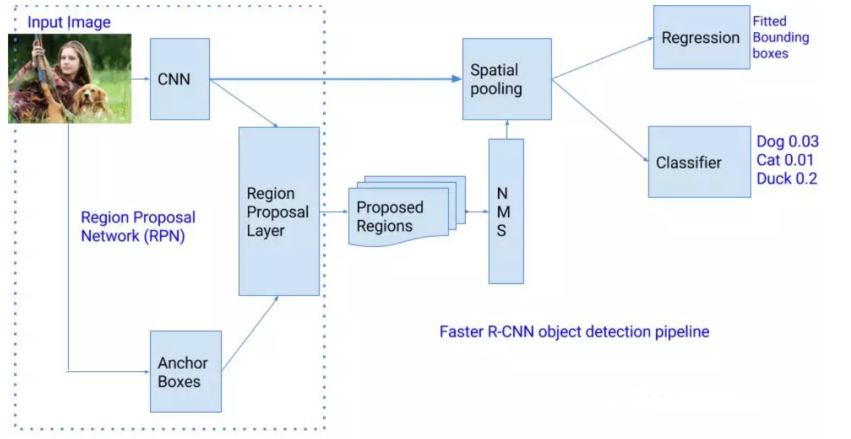
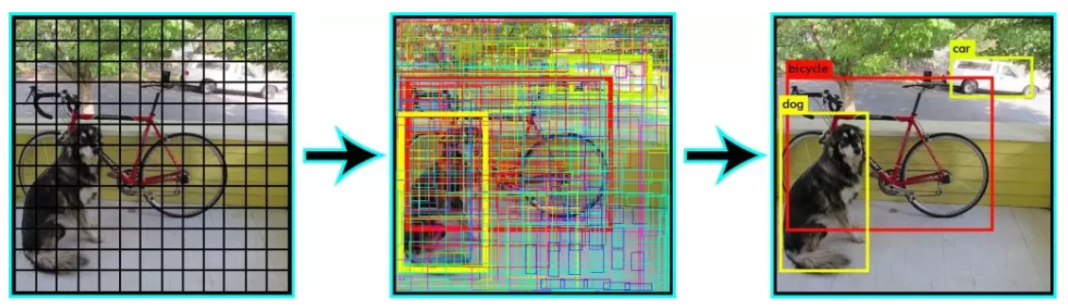
Use of AI Technology
Object Detection
Two-stage algorithm
Stage 1: select region proposal
Stage 2: execute bbox regression and classification
R-CNN, SPP-Net, Faster R-CNN ……
One-stage algorithm
Take an input image and learns the class probabilities and bbox coordinates simultaneously
SSD, YOLO ……

Slide 12
Deployment and Payoff
70%
80%
60%
Efficiency
Privacy
Cost
CentVision: At least half a month to process and deploy.
FedVision：real-time; he system administrator can finish labeling the images by himself.
CentVision：send raw data to database, which had been proven unsafe and vulnerable to data leakage.
FedVision：keep dataset on device locally, which can significantly mitigate many of the systemic privacy risks.
CentVision：a total of 100 channels required, these 100 channels require at least 50 MB/sec of network .
FedVision：the network bandwidth required for model updateis significantly reduced to less than 1 MB/sec.。

Slide 13
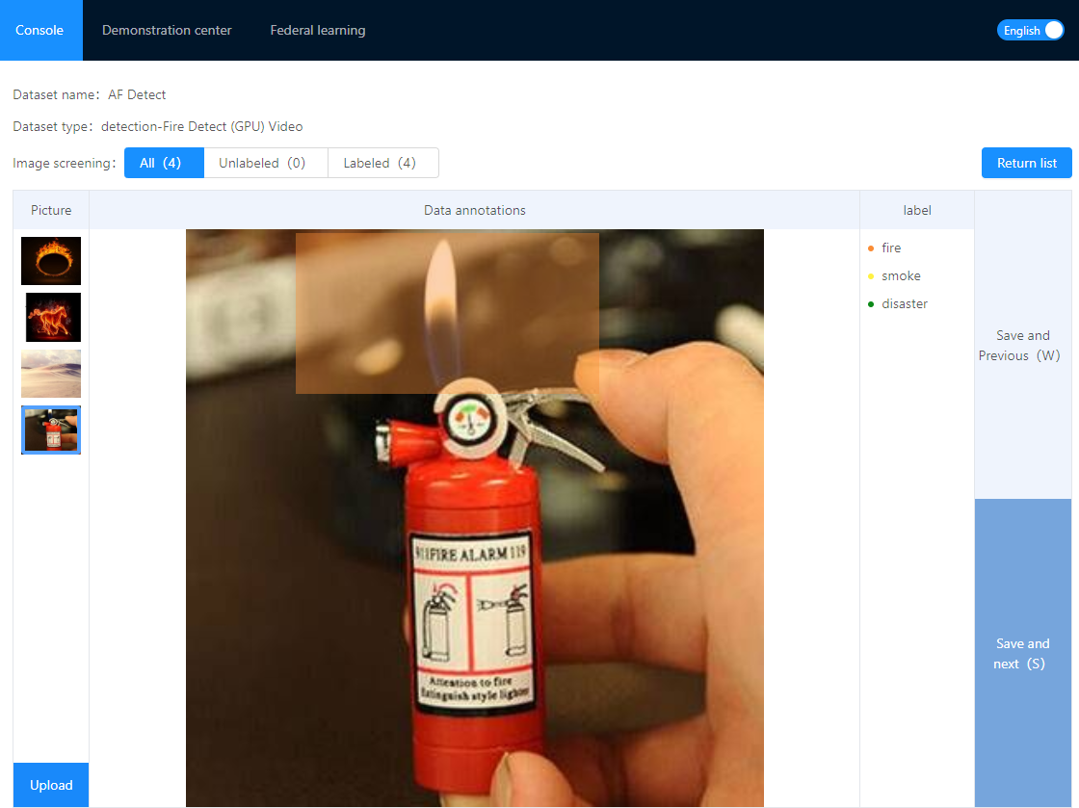
User Interaction Design

Slide 14
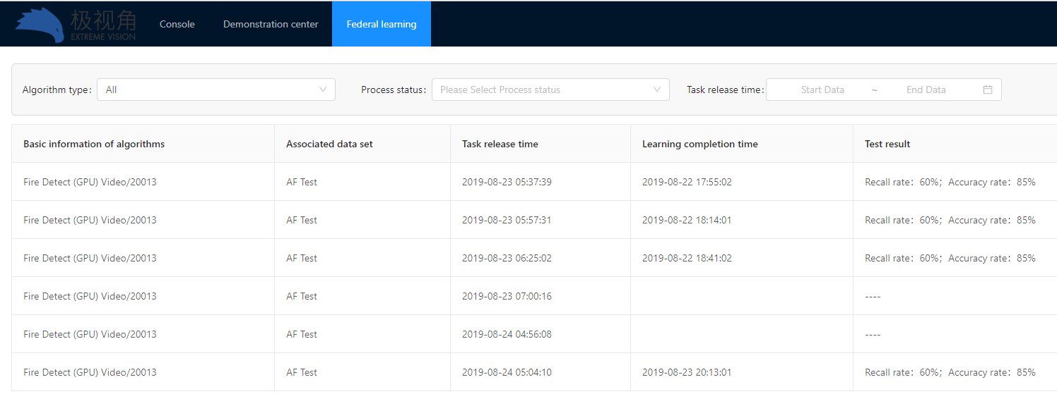
User Interaction Design

